Slide 1
Gobierno Electrónico: Oportunidades con los Datos de las Redes Sociales
GEITEC2019 – Curso Ejecutivo
Dra. Lorena Recalde
Universidad Técnica de Manabí - Ecuador

Slide 2

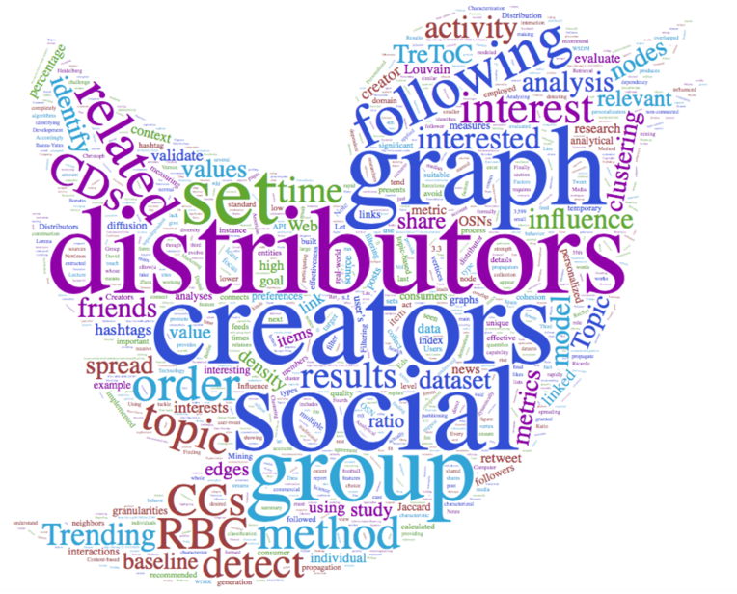


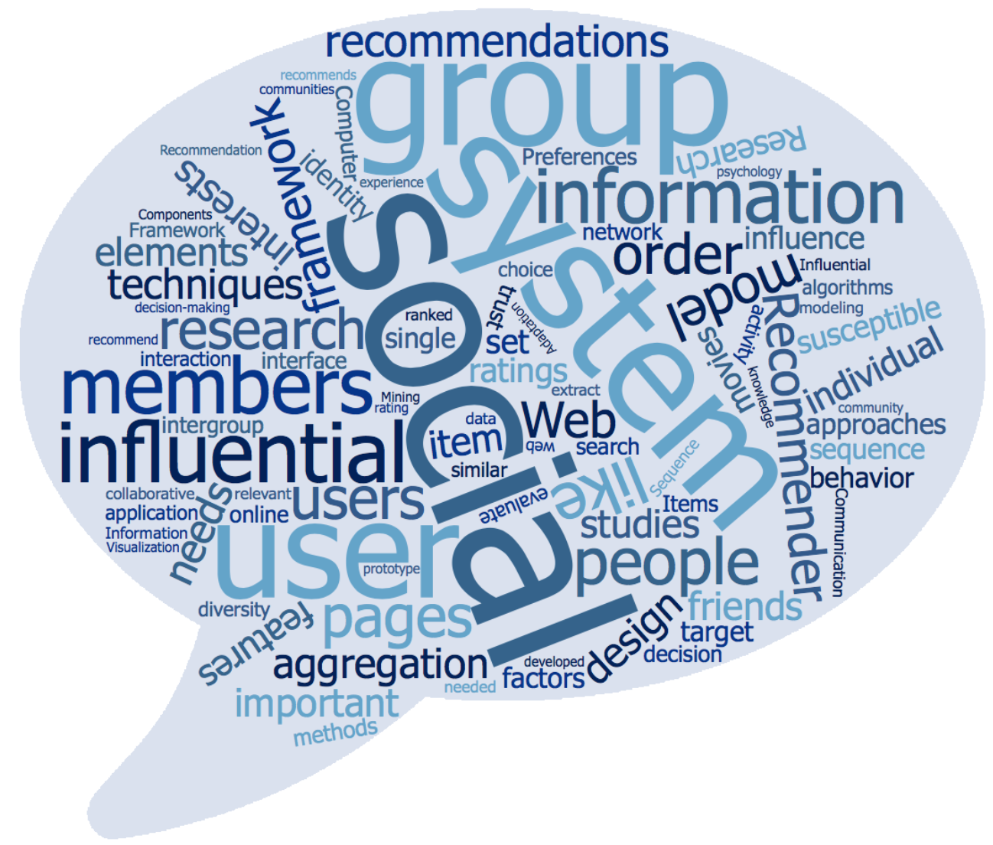

Un poco sobre mi background
Planificación Urbana Cognitiva
#TrendingTopicCommunities
#DegreeOfInterestPolitics
#MultiTopicPreferenceModel
#HashtagHijackers

Slide 3

Las Redes Sociales, imposible ignorarlas…
En Twitter:
El primer tweet fue enviado el 21 de marzo de 2006 por Jack Dorsey, el creador de Twitter.
Llevó más de tres años, hasta finales de mayo de 2009, alcanzar el billonésimo tweet.
Hoy en día, se necesitan menos de dos días para que se envíe 1 billón de tweets.
Cada segundo, en promedio, se twittean alrededor de 6.000 tweets.
En Facebook
300 millones de fotos subidas por día
Cada segundo se crean 5 nuevos perfiles
En el día, 1.52 billiones de usuarios ingresan a su cuenta de FB
http://www.internetlivestats.com/twitter-statistics/
https://zephoria.com/top-15-valuable-facebook-statistics/
Notes:
https://www.ncronline.org/blogs/just-catholic/globalization-technocratic-paradigm

Slide 4

Impacto en el Gobierno Electrónico
Nuevas formas de participación: ya sea cambiando o replicando las relaciones sociales existentes.
Capacidad para participar plenamente en la sociedad.
Datos abiertos, colaboración y participación ciudadana.
Compromiso cívico y participación democrática.
Interacción entre partidarios de un grupo político.
Votación
Uso en acciones masivas (activismo)
Los investigadores siguen considerando la relación emergente entre el uso de las redes sociales y la participación cívica
Notes:
Opportunities of research
information technology enhances information capacity and mobilizes civic participation
Philadelphia Police had an active social media presence, posted the video and images of the suspect in Youtube, Twitter and Facebook
Have caught close to 100 suspects using social media
This suspect turned himself in within hours of the posting, claiming he had nowhere to hide.
Philadelphia police use social media mostly for broadcast
Rare twitting activity, more or less 10 times/day. To avoid overwhelming people, SM would be not useful.
Reach out on multiple channels with clear requests for feedback in more traditional ways: video, message to the community, instructions, details about the suspect
The impact of OSNs is visible in market, academia,
OSN: Creation and exchange of user-generated content
‘the Facebook revolution’3 or ‘the Twitter revolution’. Yet, this celebration of the emancipatory power of communication technologies has not been much help in understanding how exactly the use of these media reshapes the ‘repertoire of communication’ (Mattoni, 2012) of contemporary movements and affects the experience of participants.
They are often used as a means of representation, a tool of ‘citizen journalism’ employed to elicit ‘external attention’ (Aday et al., 2010), for example in the use of web live-stream services like Bambuser,4 or YouTube videos documenting episodes of police brutality. Yet what is more interesting, and what has possibly brought them so much attention, is their ‘internal’ or ‘local’ use: their use as means of organisation of collective action, and more specifically as means of mobilisation in the crucial task of ‘getting people on the streets’
(Lievrouw, 2009: 154).
Social media can be seen as the contemporary equivalent of what the newspaper, the poster, the
leaflet or direct mail were for the labour movement. They are means not simply to convey abstract opinions, but also to give a shape
to the way in which people come together and act together, or, to use the metaphorical language that will be adopted in this book, to
choreograph collective action.
OSN: Creation and exchange of user-generated content
‘the Facebook revolution’3 or ‘the Twitter revolution’. Yet, this celebration of the emancipatory power of communication technologies has not been much help in understanding how exactly the use of these media reshapes the ‘repertoire of communication’ (Mattoni, 2012) of contemporary movements and affects the experience of participants.
Until recently, obtaining large-scale data was one of the key challenges in studying social interactions. Nowadays, we get around this challenge by the wealth of OSN data available on the Internet.
Understanding how users behave when they connect to these sites is important for a number of reasons. First, studies of user behaviors allow the performance of existing systems to be evaluated and lead to better site design [3, 33] and advertisement placement policies [2]. Second, accurate models of user behavior in OSNs are crucial in social studies as well as in viral marketing
However research keeps considering the emerging relationship between social media use and public engagement

Slide 5
Outline
Modelamiento de las preferencias de los usuarios y Data Mining (20min)
Case study (20 min):
Lab session (80 min)
Who is suitable to be followed-back when you are a Tweeter interested in politics

Slide 6
Modelamiento de las
Preferencias de los Usuarios

Slide 7

Interés en varios temas en mayor o menor grado.
Sports
Economy
Sports
Economy
Science
Science
Arts
Arts
Food
Politics
Politics
Food
PositiveEmotions
PositiveEmotions
Data Mining for the Social Web
Notes:
identification of users’
implicit topic preferences by analyzing the content categories they tend
to post on Twitter
In the light of the massive digital information people are exposed to, they show interest in diverse topics to a greater or lesser extent. Quantifying a user's degree of interest in certain content, measuring its correlation with his/her preference for another kind of information, finding patterns between preferences for categories, and clustering similar users to detect changes in society (or model different kinds of citizen groups) are all challenging issues, especially in OSNs where the user interests are not static.
The analysis of social media data by private corporations is well established, where the gathering and analysis of data about consumers for advertising and other purposes is critical to commercial success [1]. Social media analytics are also being debated in the social sciences as a means to analyse social processes, relationships, and behaviour [19, 30, 31].
There's going to be a huge growth in the amount of stuff out there. The problem with having all this stuff available is finding the stuff that is relevant to us. Of all the movies out there, what movie should I watch. What's the next book I should read? This problem of identifying relevant stuff is what data mining is about. Most websites will have some component dealing with 'finding stuff'. In addition to the movies, music, books, and rice cookers mentioned above, you might want recommendations about what friends to follow. How about a personalized newspaper showing just the news you are most interested in? If you are a programmer, particularly a web developer, it would be useful to know data mining techniques.

Slide 8
Qué es la minería de datos?
Descubrir patrones novedosos, interesantes y potencialmente útiles de grandes conjuntos de datos y aplicar algoritmos para la extracción de información oculta
Knowledge discovery (mining) in databases (KDD),
knowledge extraction,
data/pattern analysis,
data archeology,
data dredging,
information harvesting.
H. Jiawei and M. Kamber, Data Mining: Concepts and Techniques, Morgan Kaufmann, 2011.
Notes:
The objective of any data mining process is to build an efficient predictive or descriptive
model of a large amount of data that not only best fits or explains it, but is also able to generalize to new data [4].
data mining is the process of discovering interesting knowledge from large
amounts of data stored in either databases, data warehouses, or other information repositories.

Slide 9
Data Mining, fases
Data source
Preprocessed data
Patterns
Data
Target data
Integración
Preparación de los datos
Extracción
Preproceso
Data
Mining
Minería
Visualización
Presentación
Knowledge
9
Notes:
(i) Data preparation: prepare the data for mining. It includes 3 substeps: integrate data in various data sources and clean the noise from data; extract some
parts of data into data mining system; preprocess the data to facilitate the data mining.
(ii) Data mining: apply algorithms to the data to find the patterns and evaluate patterns of discovered knowledge.
(iii) Data presentation: visualize the data and represent mined knowledge to the user. We can view data mining in a multidimensional view.
(i) In knowledge view or data mining functions view, it includes characterization, discrimination, classification, clustering, association analysis, time series
analysis, and outlier analysis.
(ii) In utilized techniques view, it includes machine learning, statistics, pattern recognition, big data, support vector machine, rough set, neural networks, and evolutionary algorithms.
(iii) In application view, it includes industry, telecommunication, banking, fraud analysis, biodata mining, stockmarket analysis, text mining,web mining, social network, and e-commerce [3].

Slide 10
Minería en la Web Social
¿Quién está haciendo conexiones con quién?
De qué están hablando?
¿Dónde están ubicados?
¿Con qué frecuencia las personas en particular se comunican entre sí?
¿Qué conexiones de redes sociales generan el mayor valor para un objetivo en particular?
¿Cómo afecta la geografía en las conexiones online?
¿Quiénes son las personas más influyentes / populares en una red social?
¿Cuál es el comportamiento de las personas en las OSNs?
Intereses de las personas, personalidad e interacciones sociales.
Notes:
The Social Web has shown to be one of the richest sources for mining people's interests, personality and social interactions

Slide 11
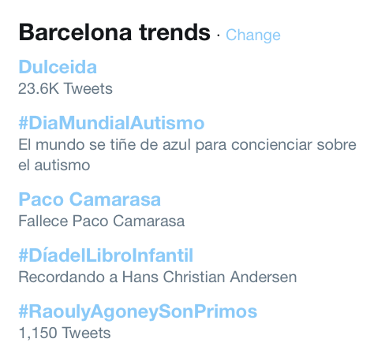
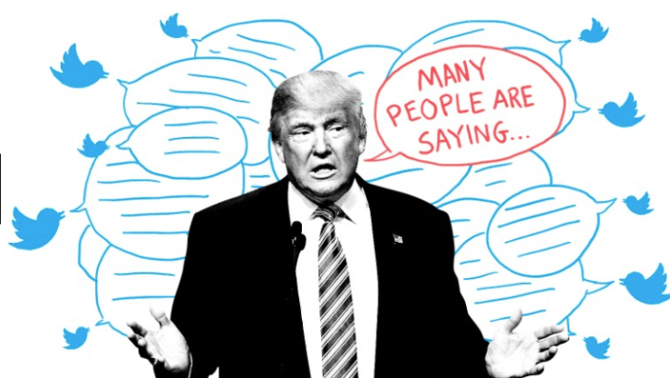
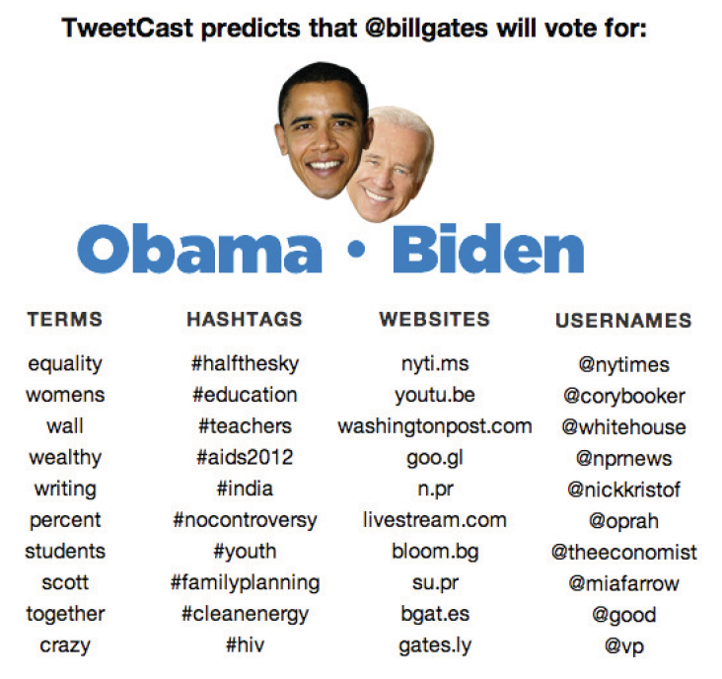
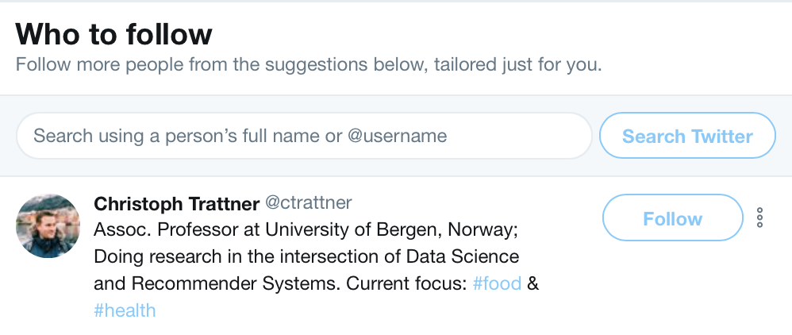
Campos de Investigación
political opinion mining
political ideology monitoring
Social entity recommendation

Slide 12
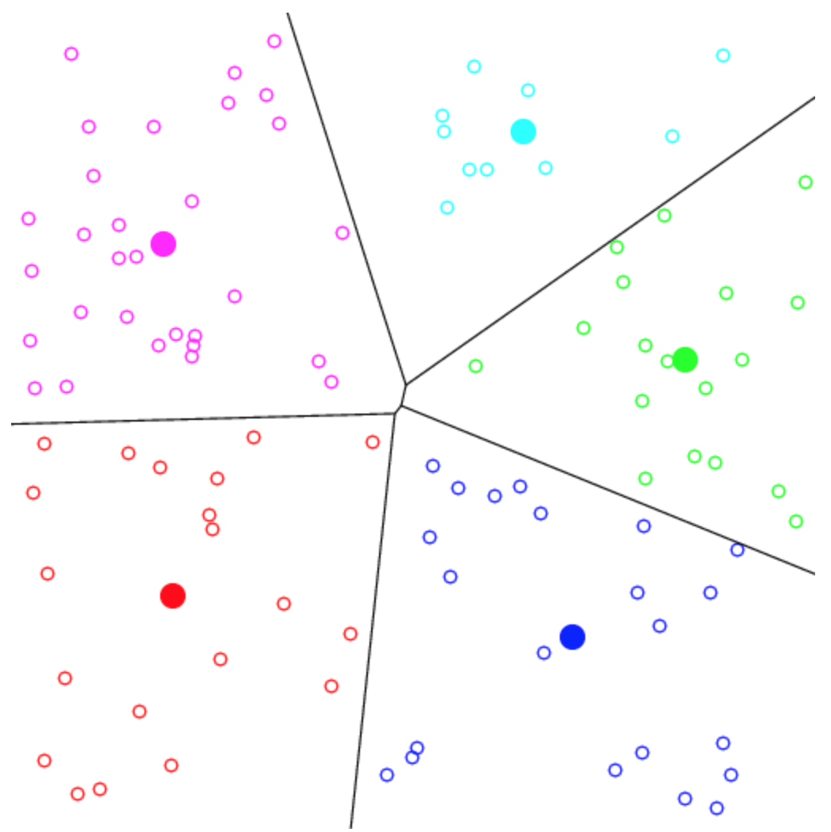
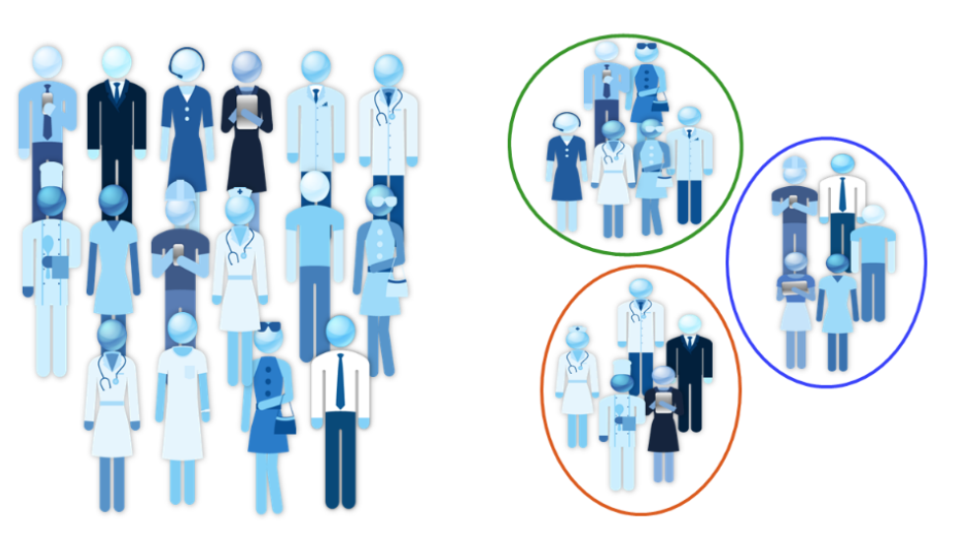
Clustering
CLUSTERING: Es necesaria la representación vectorial de observaciones.
Aprendizaje no supervisado para encontrar grupos naturales de observaciones.
OBJETIVO: encontrar las etiquetas de clase y el número de clases directamente de los datos.

Slide 13
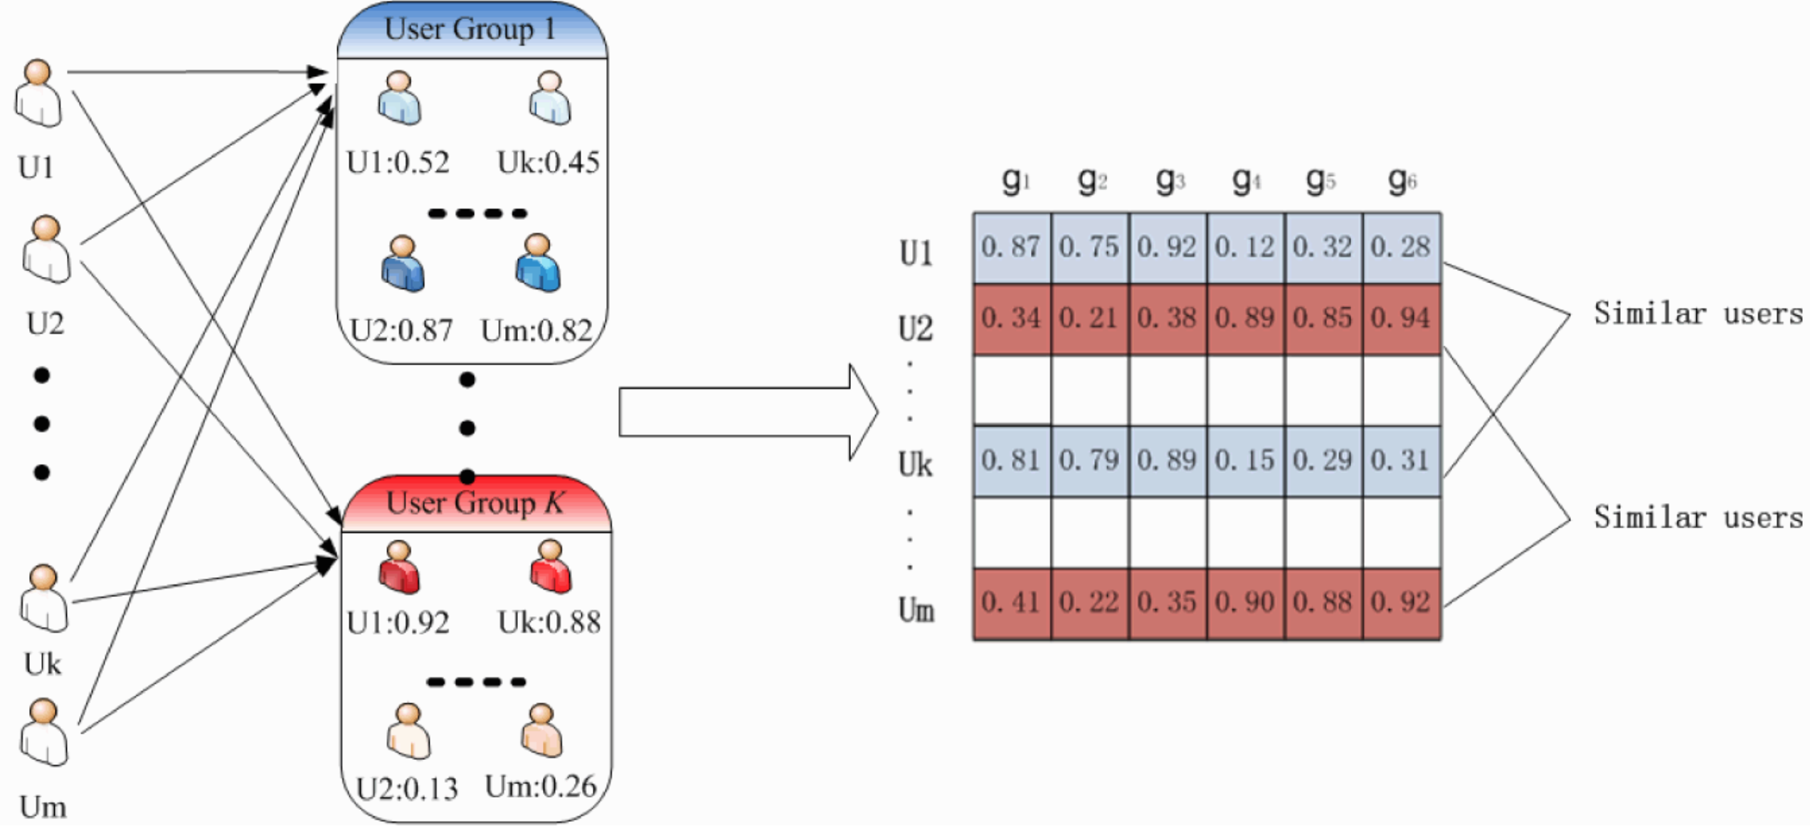
Vector modeling of observations
Y. Cai, et al. "Typicality-Based Collaborative Filtering Recommendation," in IEEE Transactions on Knowledge & Data Engineering, vol. 26, no. 3, pp. 766-779, 2014.

Slide 14
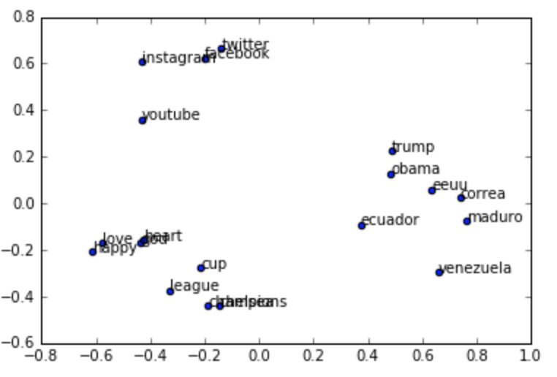
Modelado vectorial de observaciones
Texto
BoW or bag of words
tf-idf
Word embeddings
Notes:
they generate a low dimensional vector space in
which semantically similar words are close. In this study, the
authors employed the so-called neural word embeddings
and built them using Google’s word2vec4, which is the most
widely used implementation in the current literature.

Slide 15

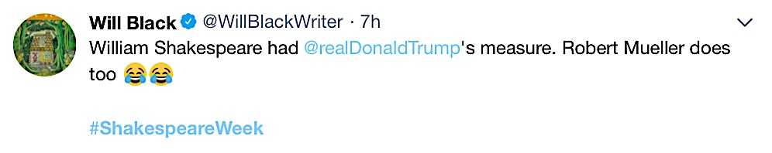




Modelado de tweets
El contenido de los tweets suele ser informal, con muchas abreviaturas, modismos y jerga.
Podemos encontrar un uso incorrecto de la gramática, lo que aumenta la dificultad de llevar a cabo un análisis lingüístico.
La longitud máxima de un tweet es de 280.
@menciones, los usuarios suelen
referirse al mismo concepto con una gran
variedad de formas cortas e irregulares.
Falta de contexto
?
,
Analysis
feeling like
Notes:
This problem is known as data sparsity,
and it is a challenge for the sentiment-topic task

Slide 16
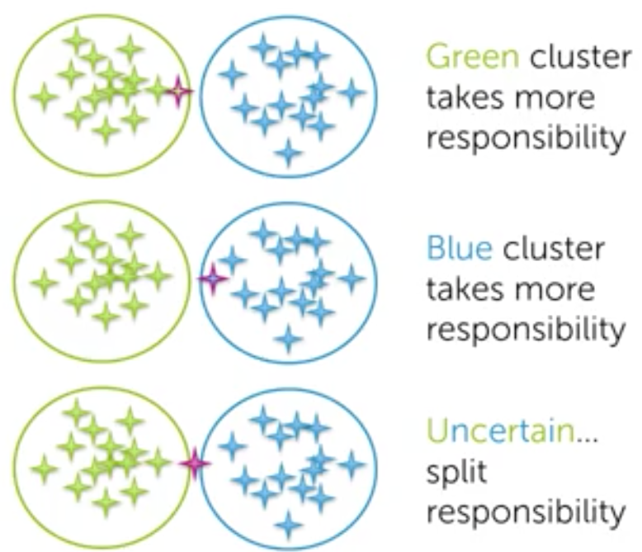
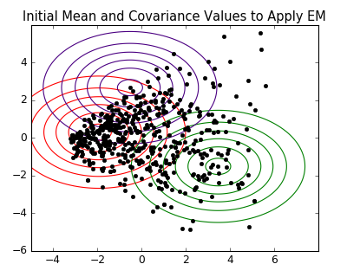
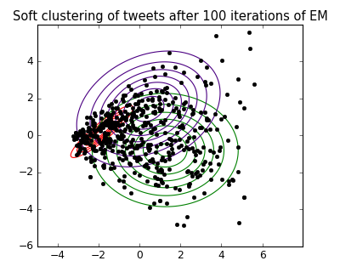
Algorithms
K-means
Mean-shift clustering
Gaussian mixture models (using the expectation maximization algorithm)
Density-based Spatial Clustering of Applications with Noise (DBSCAN)
Agglomerative Hierarchical Clustering
Hard/Soft assignments

Slide 17
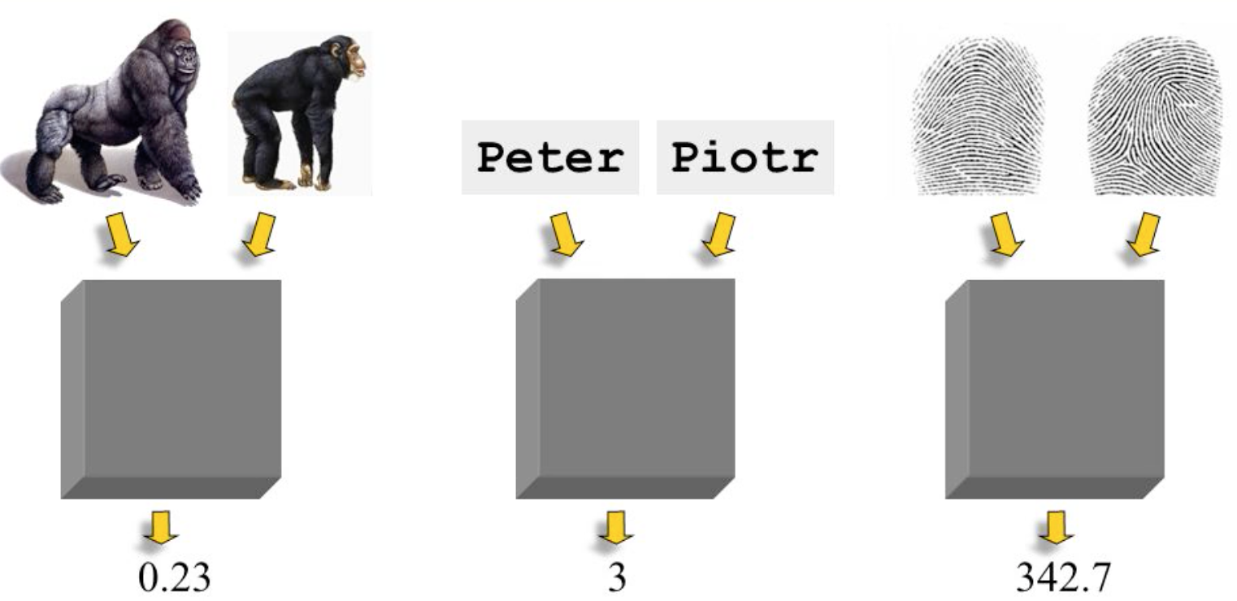
Métricas de distancia
Euclidean distance es una de las medidas de distancia más populares utilizadas en el agrupamiento basado en distancia.
Con altas dimensiones de datos, otras métricas como la similitud de coseno y el coeficiente de correlación de Jaccard se encuentran entre las alternativas más populares.
Notes:
When the dimension of the data is high, due to the issue called the ‘curse of dimensionality’, the Euclidean distances between any pair of the data loses its validity as a distance metric, because the distances will all be close to each other. In such cases other metrics like the cosine similarity and the Jaccard correlation coefficient are among the most popular alternatives.

Slide 18
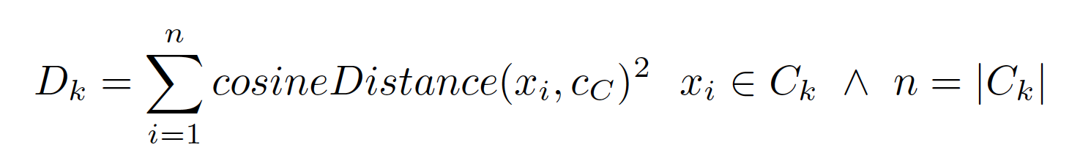
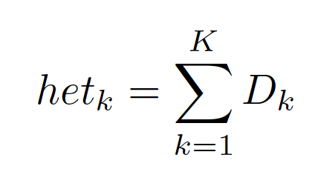
Extracción del número adecuado de tópicos: Heterogeneity Convergence Metric
1. Intra-cluster Distance
2. Heterogeneity
n = 20
3. In the Elbow heuristic we need to visualize the curve by plotting the heterogeneity value het_{K} against the number of clusters K
Notes:
What would be an appropriate number of clusters?
w’_{t} of tweets representation extracted previously are used to find the appropriate number of clusters of tweets.
K-Means++: spreads out the initial set of cluster centroids, so that they are not too close together.
Finding an optimal set of centroids is required to have a good way to initialize EM.
Number of clusters defined by using the heterogeneity convergence metric as the Elbow method specifies.

Slide 19
Extracción del número adecuado de tópicos: Heterogeneity Convergence Metric
1. Intra-cluster Distance
2. Heterogeneity
3. In the Elbow heuristic we need to visualize the curve by plotting the heterogeneity value het_{K} against the number of clusters K
Notes:
What would be an appropriate number of clusters?
w’_{t} of tweets representation extracted previously are used to find the appropriate number of clusters of tweets.
K-Means++: spreads out the initial set of cluster centroids, so that they are not too close together.
Finding an optimal set of centroids is required to have a good way to initialize EM.
Number of clusters defined by using the heterogeneity convergence metric as the Elbow method specifies.

Slide 20
Extracción del número adecuado de tópicos: Heterogeneity Convergence Metric
1. Intra-cluster Distance
2. Heterogeneity
3. In the Elbow heuristic we need to visualize the curve by plotting the heterogeneity value het_{K} against the number of clusters K
Notes:
What would be an appropriate number of clusters?
w’_{t} of tweets representation extracted previously are used to find the appropriate number of clusters of tweets.
K-Means++: spreads out the initial set of cluster centroids, so that they are not too close together.
Finding an optimal set of centroids is required to have a good way to initialize EM.
Number of clusters defined by using the heterogeneity convergence metric as the Elbow method specifies.

Slide 21
Midiendo el Grado de
Participación de los Usuarios de Twitter
en Temas Políticos
CASO DE ESTUDIO

Slide 22

RESEARCH QUESTIONS
Aim: Measuring the “degree of interest in politics” (DoIP) of tweeters.
Política
Política
Política
Q1. ¿Es posible cuantificar el nivel de interés de un usuario en temas políticos?
Q2. El grado de interés de un usuario en la política está positivamente correlacionado con el de sus amigos?
¿Cuán interesados en la política están tus amigos?
Notes:
Twitter has been broadly considered in the literature because of its effect on recent socio-political changes in different countries and regions.
By identifying the level of interest in politics of a user we can provide them with meaningful recommendations such as political actors to follow, tweets talking about politics, and political-oriented lists, among others.
Proposed approach: Degree of Interest in Politics “DoIP” of citizens in Twitter
The degree of citizens participation and political involvement varies
Difficulty to define citizen’s degree of political participation or interest
the extent of content published every second
the dynamic linkage among users and
the wide purpose-oriented nature of Twitter
Identifying the “DoIP” to provide meaningful recommendations:
political actors to follow
tweets talking about politics
political-oriented lists (and others)
Q3. Could Q1 and Q2 be used in the design stage of a ‘following back’ recommender system?

Slide 23
Introducción: Grado de Interés de un Usuario en la Política Degree of Interest in Politics of a user “DoIP”
Dificultad para definir su interés
La cantidad de contenido publicado cada segundo
Los enlaces dinámicos entre usuarios
Amplios propósitos o naturaleza de Twitter
Identificar el “DoIP” para ofrecer recomendaciones relevantes :
Figuras políticas a <SEGUIR>
Tweets que hablan acerca de temas políticos
Listas de Twitter orientadas a la política
Notes:
Varies from person to person
Reasons of difficulty to define DoIP
Advantages of defining DoIP for a user

Slide 24
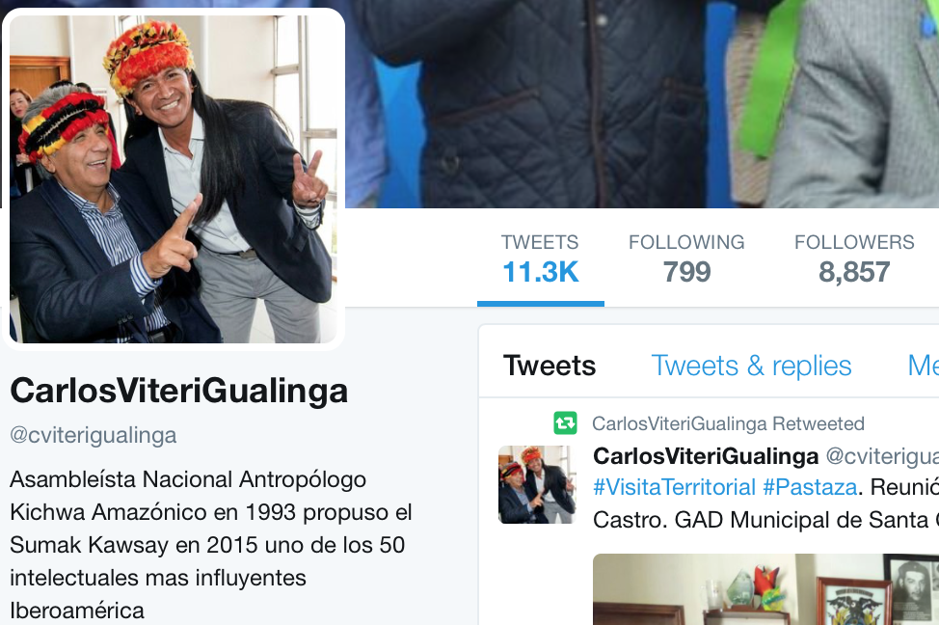
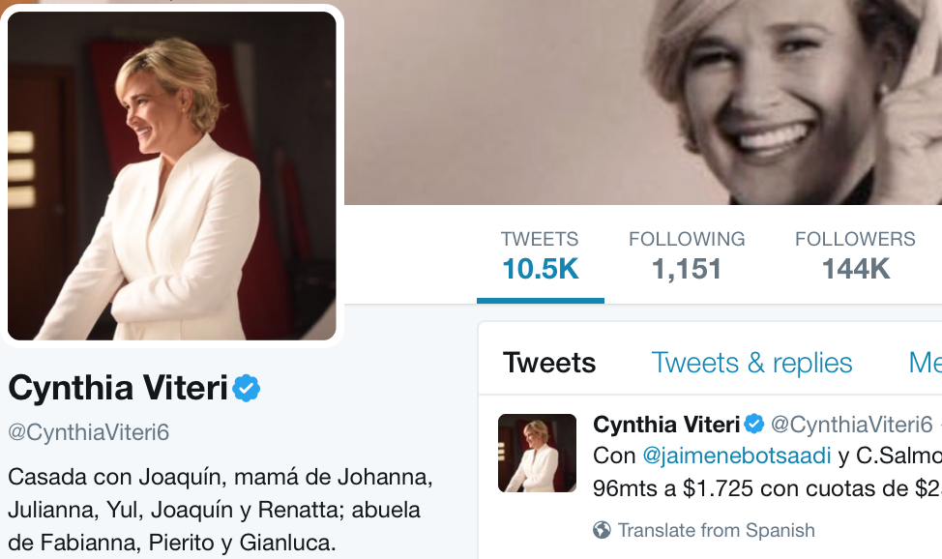
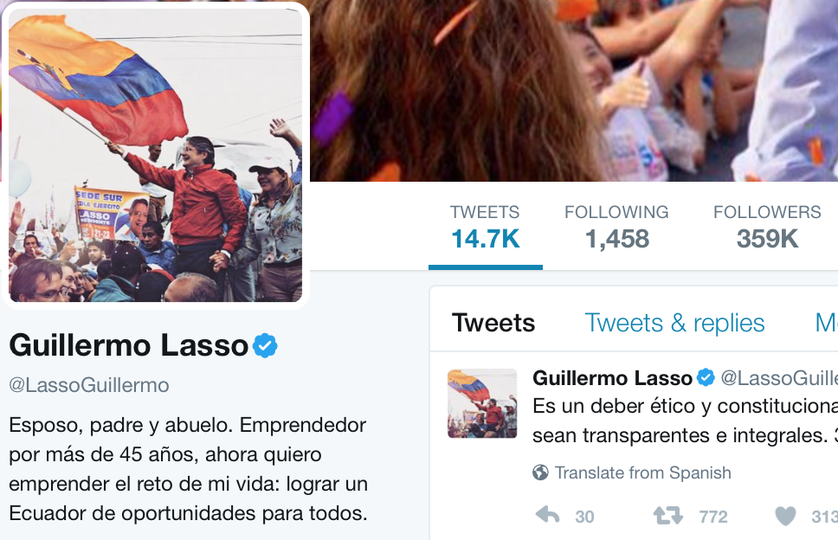
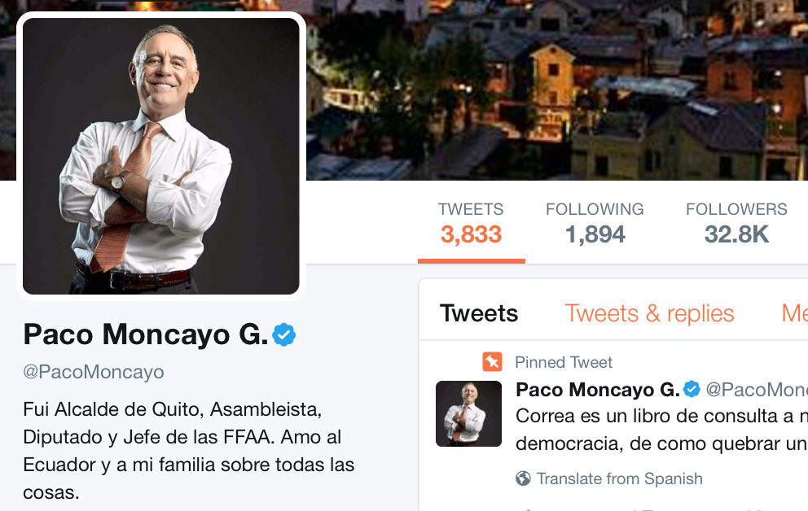
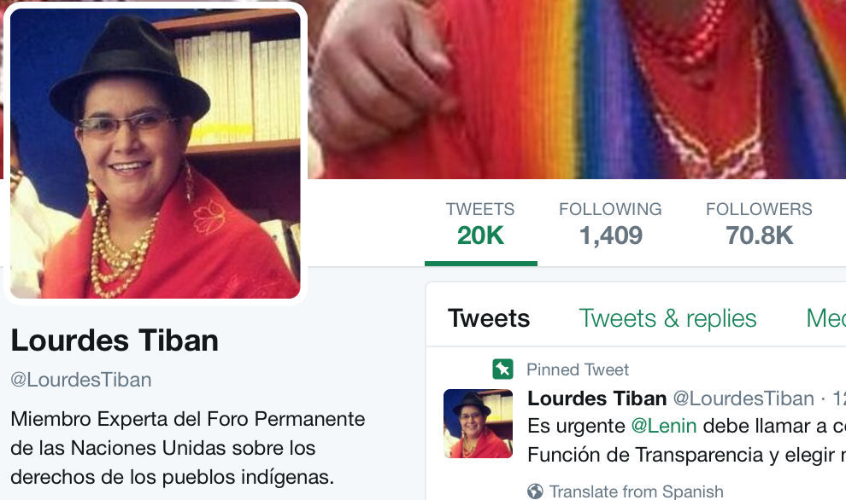
Motivación
Who is suitable to be followed-back when you are a Tweeter interested in politics

Slide 25
Diseñando un Sistema de Recomendación: following back recommender system
1. Method to detect Twitter users' DoIP
2. Correlation between users' DoIP and their Twitter friends' DoIP
3. Experiments on real data in the context of politics in Ecuador
“friend” denotes bidirectional or mutual relationship between two Twitter users
Notes:
Method
Correlation of the users' DoIP facing their Twitter friends' DoIP which can be further applied to design “following back” recommendations
Experiments on real data in the context of politics in Ecuador show the effectiveness of our approach in identifying the DoIP of Twitter citizens and the positive association of it with their friends'.

Slide 26
MÉTODO
Método para detectar el DoIP de los usuarios de Twitter
Word embeddings para representar los tweets de los ciudadanos. Calidad de resultados al aplicar word2vec vs Glove.
Calcular el DoIP de los usuarios cuantificando el número de tweets que hablan de política
Para el diseño de las recomendaciones: correlación del DoIP de los usuarios con
el DoIP de sus <amigos>
Degree of Interest in Politics of a user “DoIP”
Similitud de un tweet respecto al ‘political vector space’
Notes:
Method
Correlation of the users' DoIP facing their Twitter friends' DoIP which can be further applied to design “following back” recommendations
Experiments on real data in the context of politics in Ecuador show the effectiveness of our approach in identifying the DoIP of Twitter citizens and the positive association of it with their friends'.
“friend” denotes bidirectional or mutual relationship between two Twitter users

Slide 27
DoIP de los usuarios
Text Modeling
Calculation of DoIP of Twitter Users.
Following Back / Lists Recommendation
Text Preprocessing
Models Training and Performance Comparison
Clustering and Centroids Extraction
Similarity of a Tweet and Cluster Centroids
User’s DoIP Extraction
Notes:
1. Text Modeling. A corpus of tweets is employed to build a model with the word2vec training algorithms. The model generates a vector representation of the corpus' words.
2. Calculation of DoIP of Twitter Users. Tweets of citizens are converted into vectors by using the model so that we can apply the proposed method and measure in which extent they are interested in politics.
3. The association of users' DoIP to the DoIP of their Twitter friends can be further used to build a following back recommender system. Depending on the amount of tweets in the context of politics published by the user, we can define to what extent he/she is interested in this topic. This users characterization may be useful when modeling their political profile and then determining if a recent follower is significant to be followed back.

Slide 28
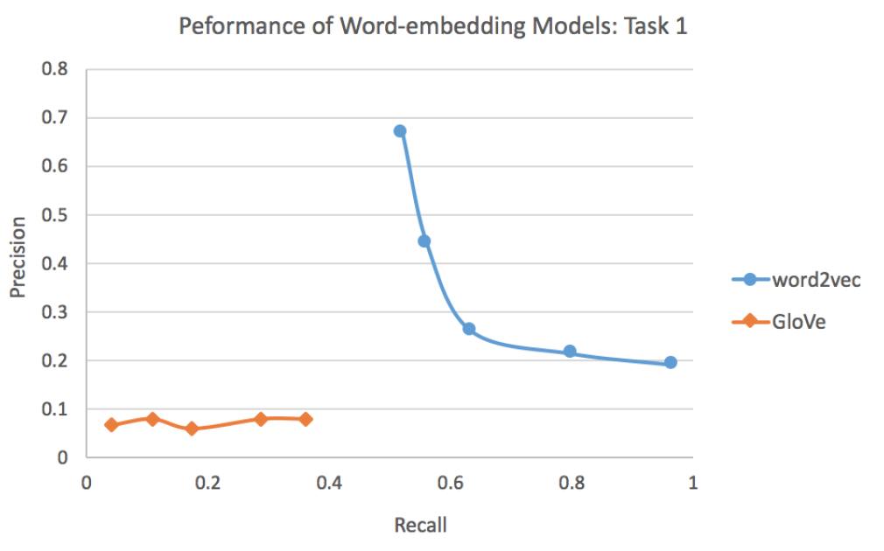
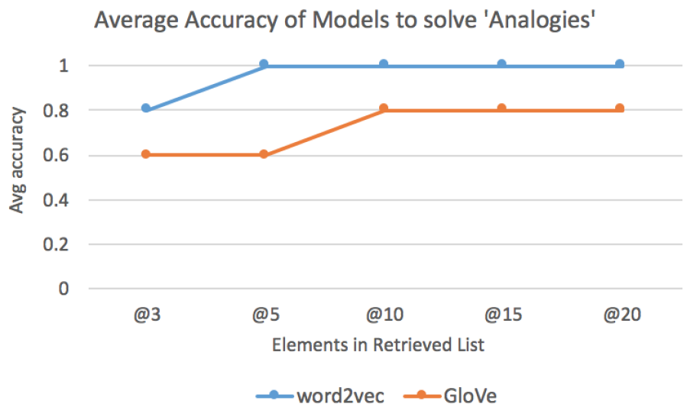
Extracción de Word Embeddings: word2vec y Glove
Task 1: Nearest words to a QUERY
Task 2: Solving Analogies
Q: dictator
Tyrant, genocide, criminal
If Donald is to Trump
Then, Clinton is to ?
Notes:
accurately solving existent relations among words. Finally,
in a global and visual way we analyzed the relationship between certain
groups of words

Slide 29
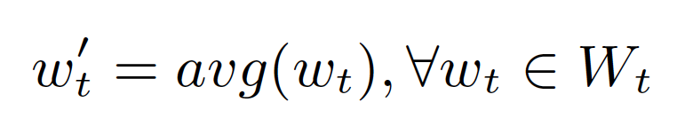
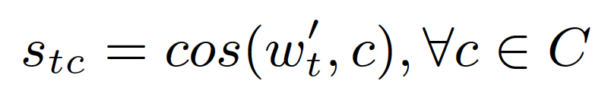
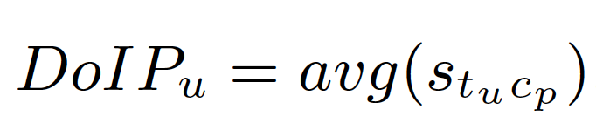
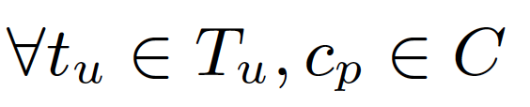

Ejemplo
t = ‘Soplan vientos de cambio para el país...’
Centroid_1
¿Cuál es la similitud de t y$c_{p}$?
Centroid_2: $c_{p}$
1.
Centroid_3
2.
Centroid_4
3.
Centroid_5

Slide 30
Datasets
Training Corpus
The corpus used to train the model contains 281,338 tweets.
Sample of Politicians
31 Politicians and their tweets were extracted.
This dataset was used to test the accuracy of our approach, defining the number of dimensions of the model (300) as well as the number of clusters (5).
Sample of Ecuadorian Twitter Users
To calculate the DoIP of digital citizens, 763 Ecuadorian users were selected.
To demonstrate the positive association of the user's DoIP and his/her
friend's DoIP, we extracted a list of 22,523 friends (bidirectional following)
of the 763 digital citizens.
Twitter Users' Friends
Twitter Users' Lists
We collected the tweets of 981 lists where the users were subscribed and the tweets of 1988 lists where the users participate as members.

Slide 31
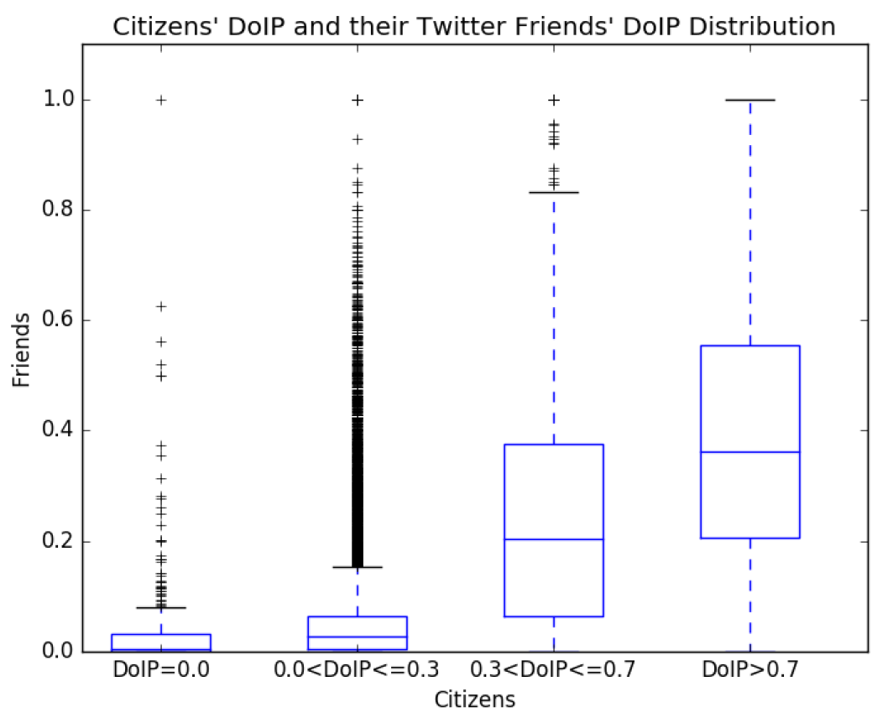
Results: DoIP of a Twitter User vs their Friends'
Positive association of users’ topics of preference with their friends’ interests
Which followers are suitable to be followed back?
Notes:
It is well known that friends share some similar interests. This assumption was verified by finding the correlation between digital citizens' DoIP and their friends’.

Slide 32
Hands-on session

Slide 33
Calcular el DoIP de usuarios de Twitter
https://github.com/lore10/GEITEC_curso

Slide 34
https://github.com/lore10
lorena.recalde@upf.edu
THANK YOU!

Slide 35
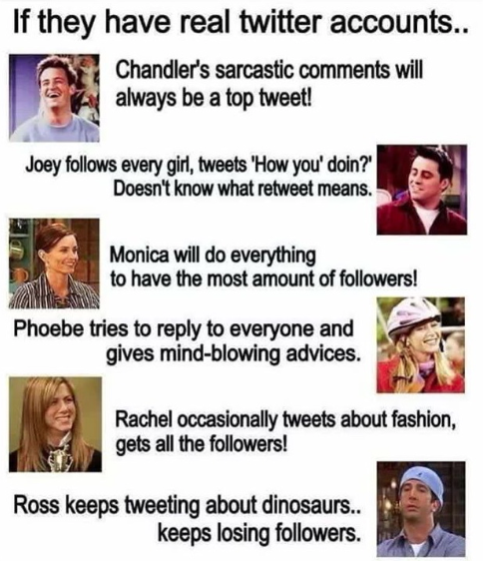
De qué manera usas Twitter? (u otra OSNs)
para obtener información política,
para participar en la sociedad online,
para buscar información online y cumplir con tus deberes cívicos,
para felicitar o quejarte acerca de los servicios públicos
para reportar fallos en el sistema social
en tu trabajo para compartir/obtener opiniones

